Slide 1
Node-RED – WoT-Discovery Integration
Kunihiko Toumura
2020.10.1

Slide 2

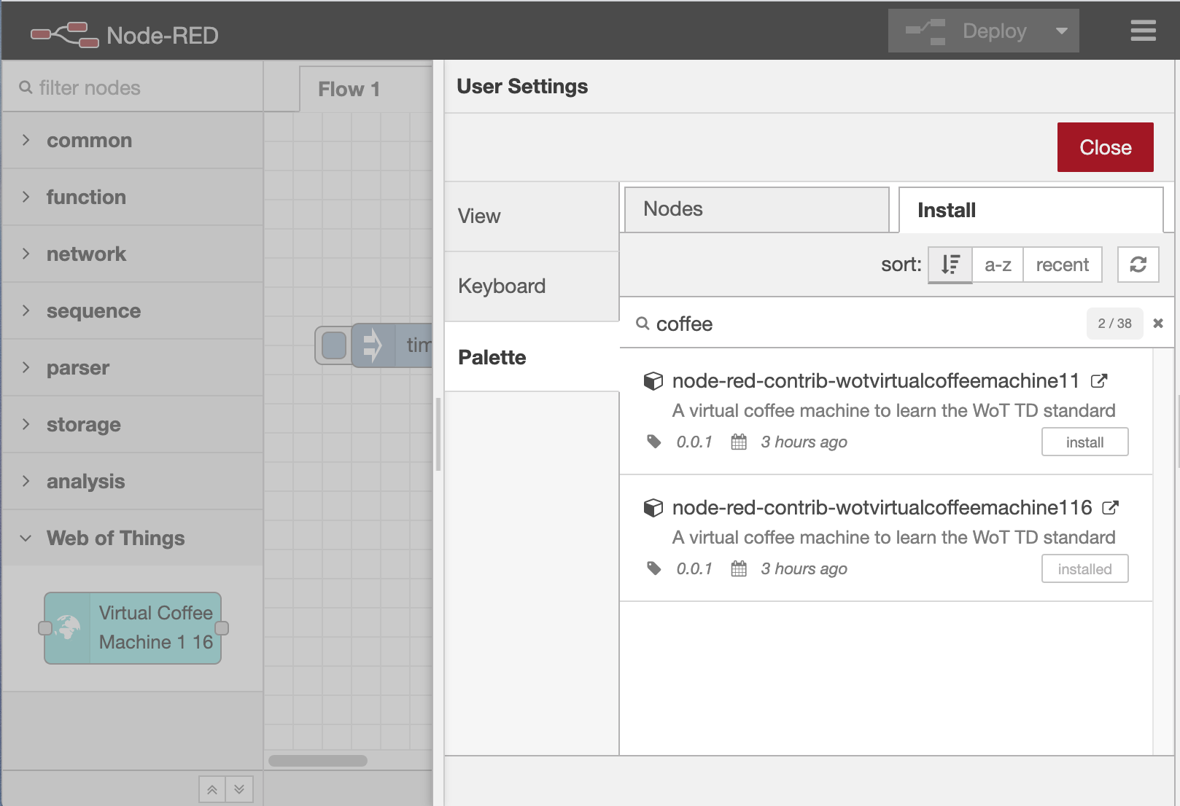
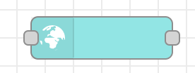
Overview
In last plugfest, we developed an Auto-population server which uses Linksmart’s TD Directory Service.
On this plugfest, we are developing another auto-population server which uses DNS-SD/mDNS
Things
Node-RED
mDNS
advertisement
Auto-population Server
mDNS
listener
Generate a catalogue
Catalogue
Server
Node
Generator
Generate
node
modules
Retrieve
a catalogue
and
node
modules
Retrieve
TDs
Installed
WoT node
Node Catalogue

Slide 3
Sequence diagram
Auto-population server
Thing
mDNS
Listener
Node
Generator
Catalogue
Server
Node-RED
Antwapp4hc._wot._tcp
type=Thing
td=/td/nhktv.jsonld
Address=192.168.30.132
Port=8887
GET /td/nhktv.jsonld
Thing Description
Thing Description
Generate a node
Node module
Update catalogue
GET /catalogue.json
Module catalogue
GET /module archive.tar.gz
Module
install

Slide 4
